Slide 1
PBHS 31001 – Epidemiologic Methods Winter 2024 Stata Session #1
Adapted from previous TAs’ slides

Slide 2
Topics to be discussed
Primary orientation on STATA
Access and open data sets (different formats, reshape)
Explore variables (codebook, describe, label, create/modify)

Slide 3
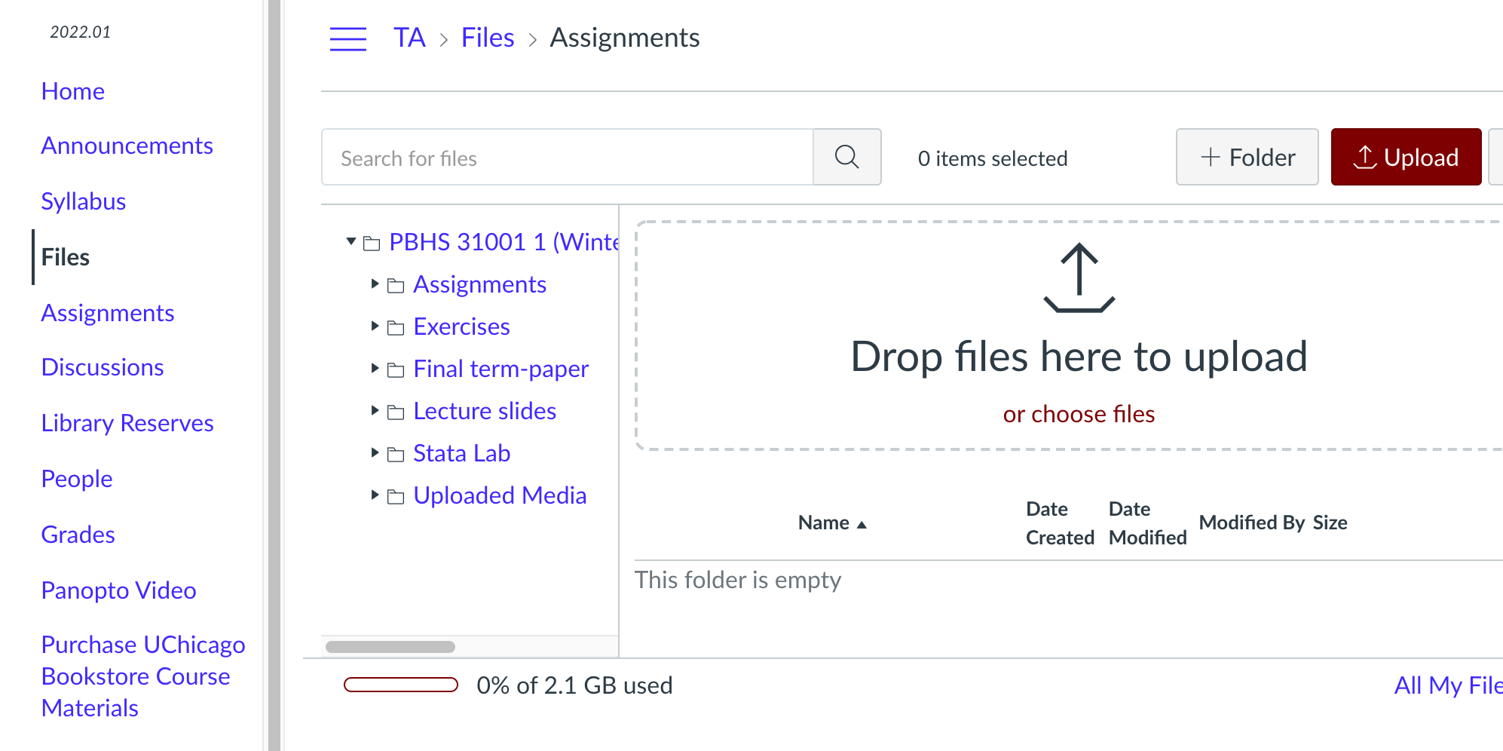
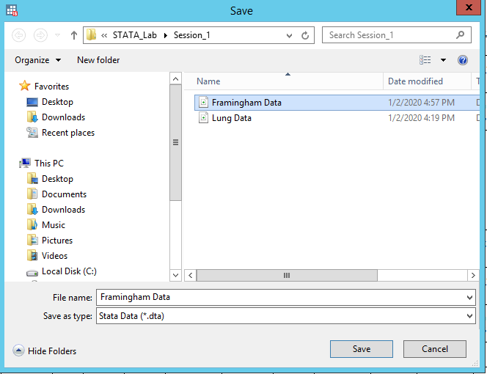
Download the data from Canvas-Files-Assignments
Save the data

Slide 4
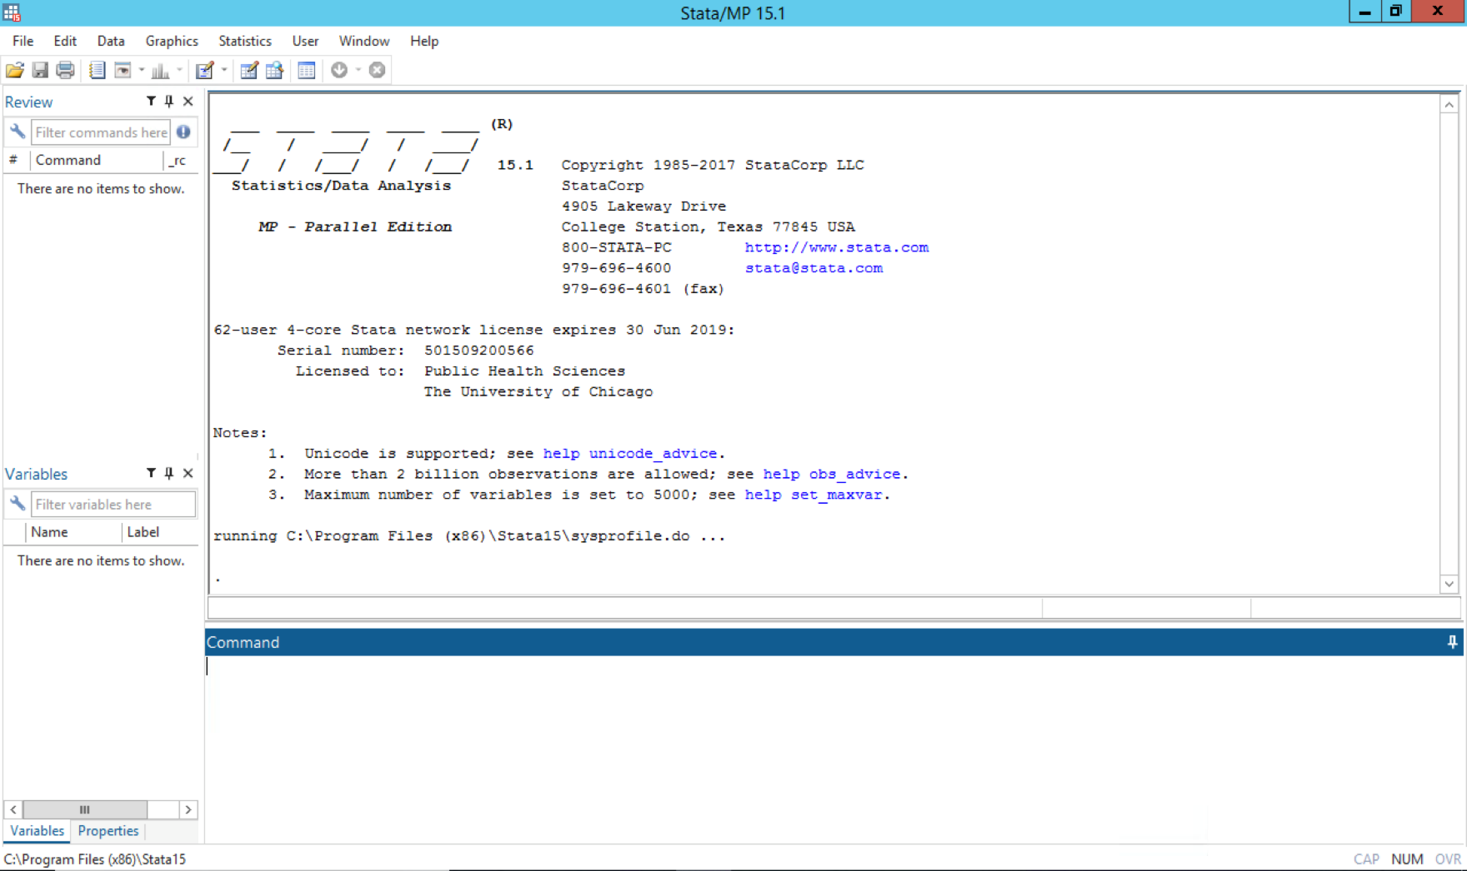
Access Stata
Purchase options
UChicago Virtual Lab (free)
For those who do not wish to purchase the STATA app
You can use the app through the UChicago Virtual Lab (vLab)
https://academictech.uchicago.edu/vlab/
Follow the Recommended Method to set up and access to STATA or any other apps in the vLab

Slide 5
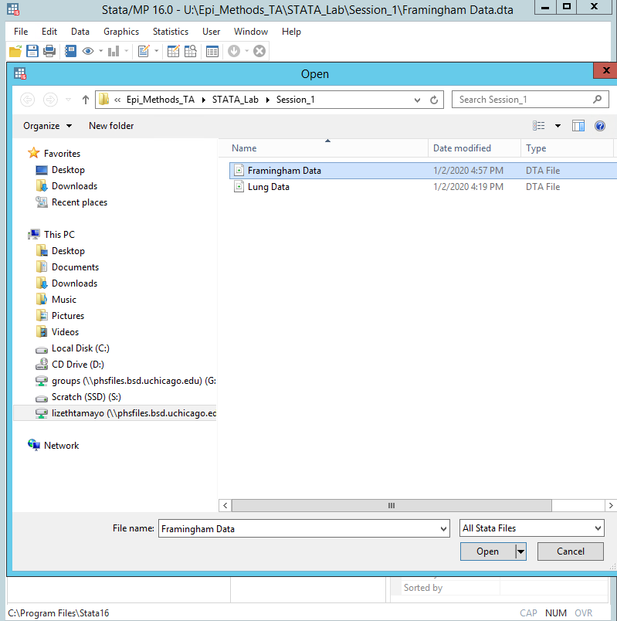
Open the .dta

Slide 6
Alternate way to open
PC
use "U: Epi_Methods_TA\STATA_Lab\Session_1\Lung Data.dta", clear
Mac
use "/Users/Epi_Methods_TA/STATA_Lab/Session_1/Lung Data.dta", clear
Opening files
Syntax:
use “[filepath][filename].dta”, clear
Opens the Stata dataset [filename], and discards anything currently in memory

Slide 7
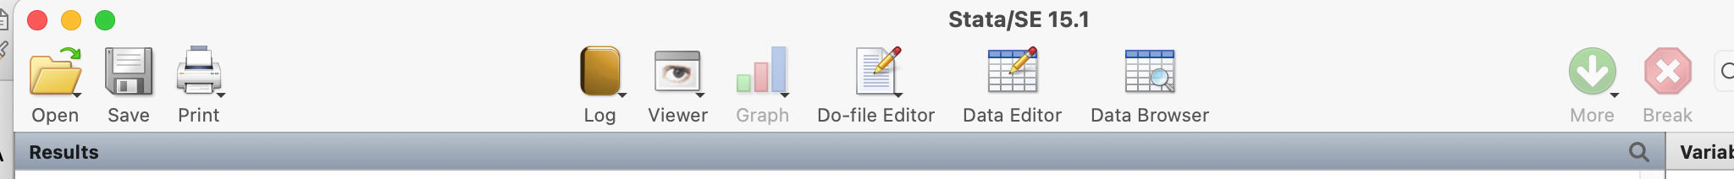
A note on good practice
Use a do-file editor, and run your commands from there
This allows you to have a history of the commands you used
Your memory will be worse than you think it is
Save do files vs. save .dta
Cautious about saving .dta since it changes the original data (not recommended)
Creating a .do file

Slide 8
A note on good practice
Creating a .log file
Although less necessary than in the old days, creating a log file of your output is also good practice
Do this by typing
log using [filename], text

Slide 9
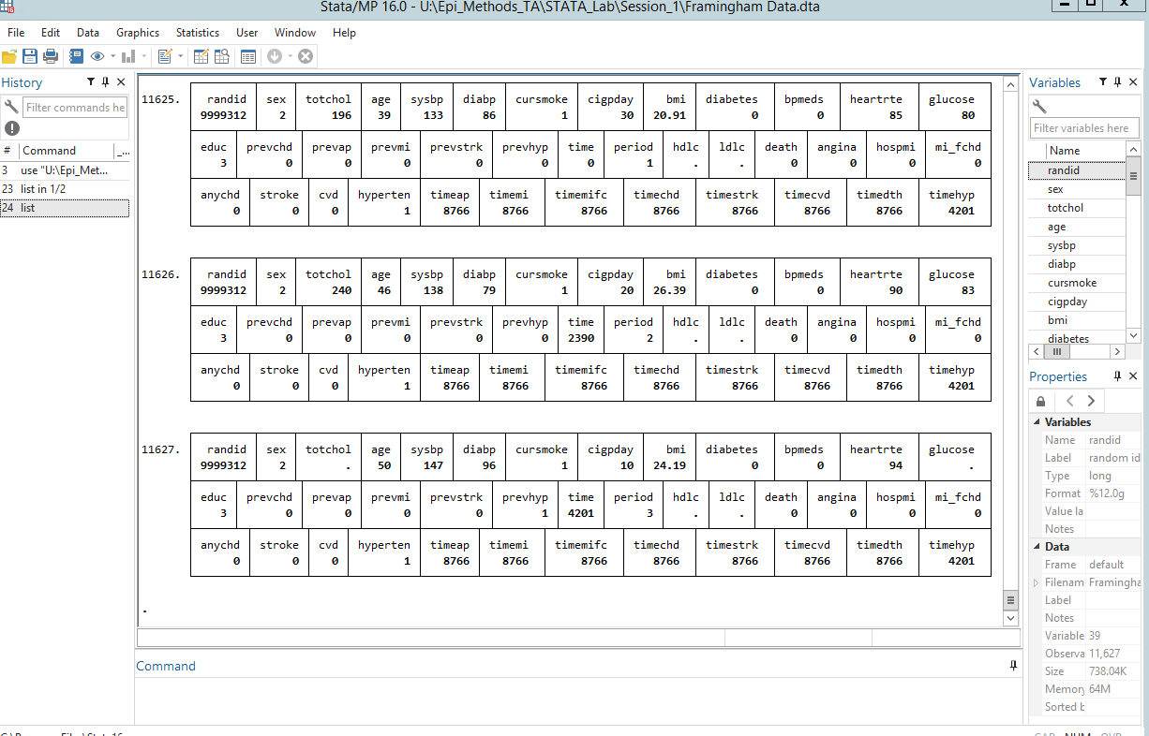
Explore the data: list
Too much data for this command to be useful this way
We can use list in a more useful manner

Slide 10
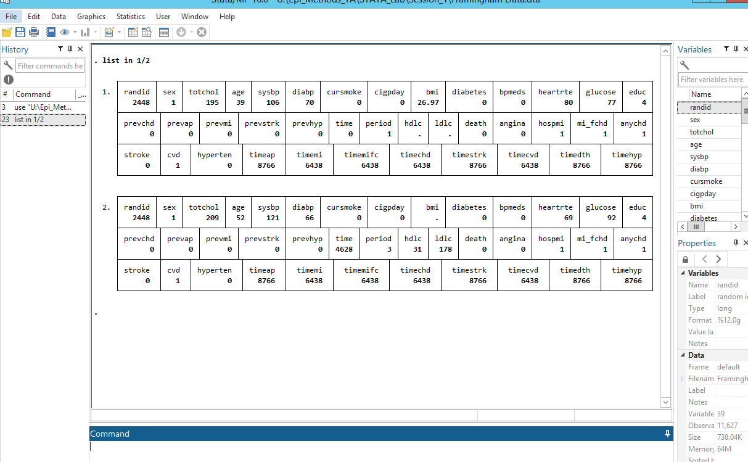
Explore the data: list
. list randid sex age sysbp diabp in 1/2
+------------------------------------+
| randid sex age sysbp diabp |
|------------------------------------|
1. | 2448 1 39 106 70 |
2. | 6238 2 46 121 81 |
+------------------------------------+
code: list randid sex age sysbp diabp in 1/2
(We can display selected variables in specific rows as well!)

Slide 11
Examine the Data
.describe
.sum [varname]
.tab [varname]

Slide 12
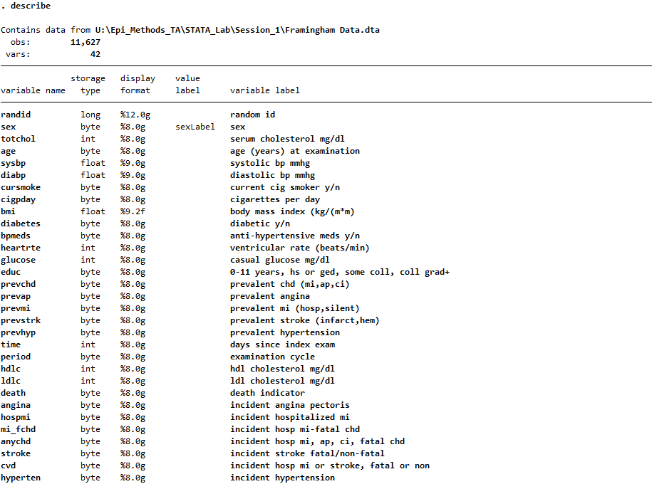
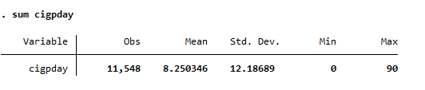
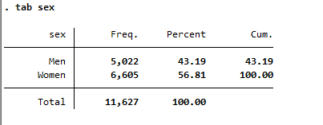

Slide 13
Extended options for tab
Sometimes you want a 2x2 table
tab [varname1] [varname2]
Sometimes you want the row or column percent, not just the numbers
tab [varname1][varname2], row
tab [varname1][varname2], col

Slide 14
Caution with the tab command
By default, the tab command will omit data that are missing
To report missing data, add the “missing” option
tab [varname], missing

Slide 15
Creating/Modifying variables(columns)
Generate cigpack = cigpday/20
Replace cigpack = cigpday/25
Replace cigpack = cigpday/20 if sex==1
Please Note: Stata is case-sensitive, so cigpack is a different variable than CigPack(or CIGPACK, or ciGpaCk)

Slide 16
Creating/Modifying variables(columns)
It is always good practice to make sure that any variables you made were created the way you expected them to
Pay particular attention to missing data, and extreme values
In Stata, a missing number counts as infinity
So be careful with statements like
replace ageCat=“Old” if age>95; this would be wrong if missing data presents

Slide 17
Creating/Modifying variables(columns)
Syntax:
generate [newVarName]=[rule for generation]
replace[varName]=[rule for generation]
Can only use generate once per variable
Can only use replace after already generating the variable

Slide 18
Make output easier to interpret
Decimals, dates, and times are often displayed in less-than-optimal ways
solved with format
Categorical variables are often listed as numbers, which can be less than transparent
solved with label

Slide 19
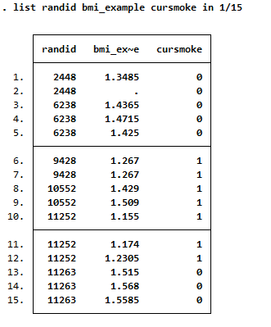
Format
BMI has a varying number of decimal places, which can make it difficult to compare between subjects

Slide 20
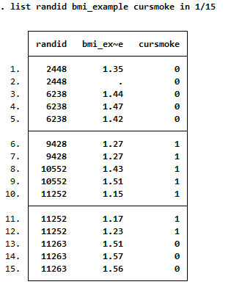
Format
. format bmi_example %9.2f
Will display BMI as a number with (at most) nine digits before the decimal place, and two digits after it

Slide 21
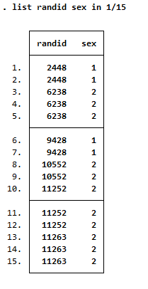
Label
Sex is coded as
1=Men
2=Women
Important to the analyst (you) if you can put that information directly into the data

Slide 22
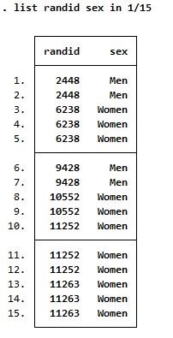
Label
Syntax:
. label define sexLabel 1 "Men" 2 "Women"
. label values sex sexLabel
Displays the longer variable name in list and tabulate commands
Does not actually change the value of the variable

Slide 23
Label
Syntax:
. label define[nameOfLabel] [value1] “[label1]” [value2] “[label2]”... [value#] “[label#]”
. label values [varYouWantToLabel] [nameOfLabel]

Slide 24
Modifying variables
Sometimes you want to make categories of a variable (such as age)
If the variable you want to recode is numeric, this can be done easily using the recode statement, which combines a sequence of “generate,” “replace,” and “label” statements
recode age (min/39=0 "30's") (39/49=1 "40's") (49/59=2 "50's") (59/max=3 "60 plus") , gen(ageCat)
This will create a variable, ageCat, using the rules in the parentheses, and labeling it appropriately
Note that the “min” and “max” options avoid problems with missing data. With this code, if age is missing, then ageCat will be missing

Slide 25
The recode statement
recode [existingVariable] ([lowerbound1]/[upperbound1]= [recode1] “[label1]”) ([lowerbound2]/[upperbound2]= [recode2] “[label2]”)... ([lowerbound#]/[upperbound#]= [recode#] “[label#]”), gen([newVar])

Slide 26
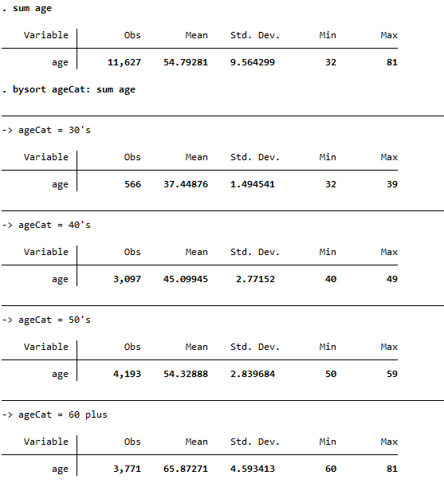
Verify new variables
After creating a new variable, it is always good practice to make sure it got created the way you expect, using the bysort command, mixed with the sum command
bysort ageCat: sum age

Slide 27
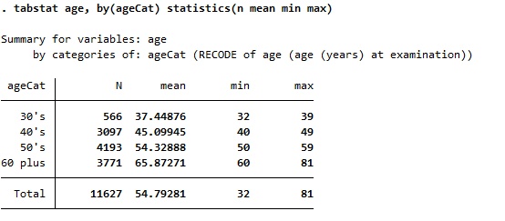
Verify new variables
The same check can also be done using the tabstat command

Slide 28
Verify new variables
.bysort [categoryVariable]: sum [originalVariable]
. tabstat[originalVariable], by([categoryVariable]) statistics(n mean min max)

Slide 29
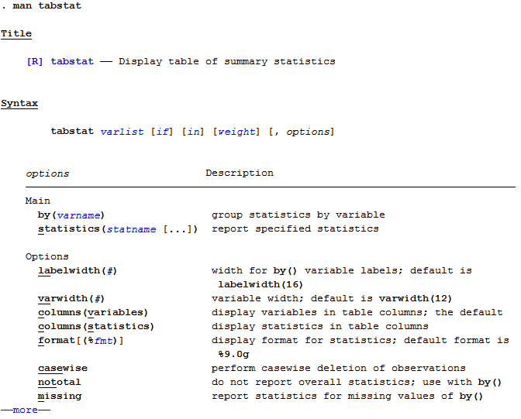
Documentation
The commands you will use for this course can almost all be extended to do very interesting things
If you are curious about these things, or need help figuring out how to use a command, Stata has documentation that is quite good
. man [command name]

Slide 30
Reshaping data
Wide format: repeated observations at different times for each subject
Long format: each row represents just observation at one time, and there is a new column indicating time of observation.
Different data analysis may require wide or long format. We can reshape easily in stata.

Slide 31
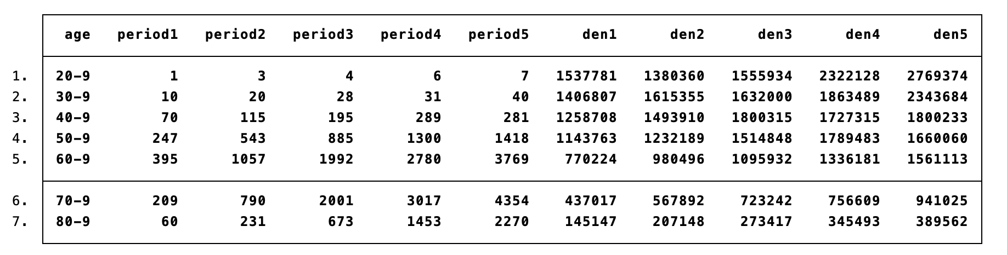
Wide

Slide 32
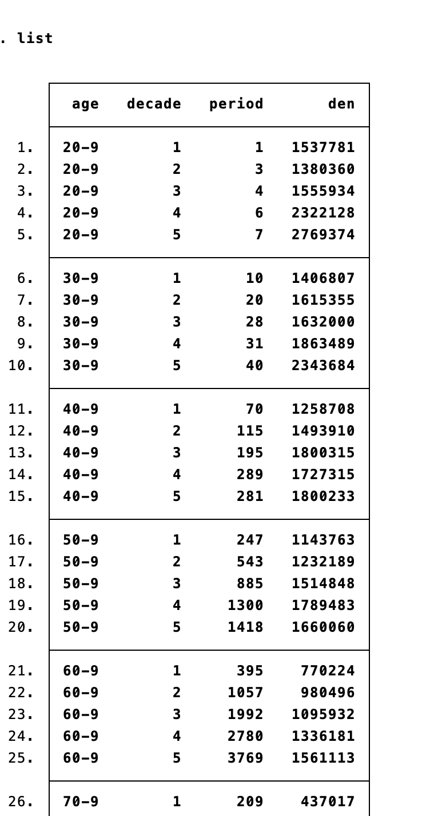
Long

Slide 33
Reshape
Syntax:
. reshape long/wide var1 var2…, i(var with repeated obs) j(name of time indicator)
Use lungca.dta
Long
Reshape long period den, i(age) j(decade)
Wide
Reshape wide period den, i(age) j(decade)

Slide 34
Table 1
The table1 in Stata: can generate a customizable table 1 of characteristics for a manuscript, which might contain a collection of baseline characteristics (continuous/categorical).
https://blog.stata.com/2021/06/24/customizable-tables-in-stata-17-part-3-the-classic-table-1/
https://blog.uvm.edu/tbplante/2019/07/11/make-a-table-1-in-stata-in-no-time-with-table1_mc/

